Slide 1
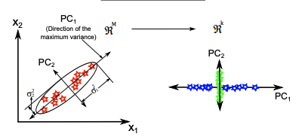
Singular Value Decomposition in Principal Component Analysis
Aidan Olson
Notes:
My presentation is about the role of the SVD in PCA

Slide 2
Motivation behind pca
Extract important information from data set
Variance
Primary Components
Compress dataset size while retaining essential features
Simplify data by reducing dimensions
Identify correlations between variables
Covariance

Slide 3
Statistical Approach to PCA
Center data around mean
Compute Covariance Matrix
Eigen system of Covariance matrix
CV = VΛ
Eigenvalues represent variances along principal axes
Eigenvectors represent directions of principal axes
Extract Principal Components and Interpret Results
T = BV are projections of data onto principal axes
Diagonal matrix Λ stores variance explained by each PC

Slide 4
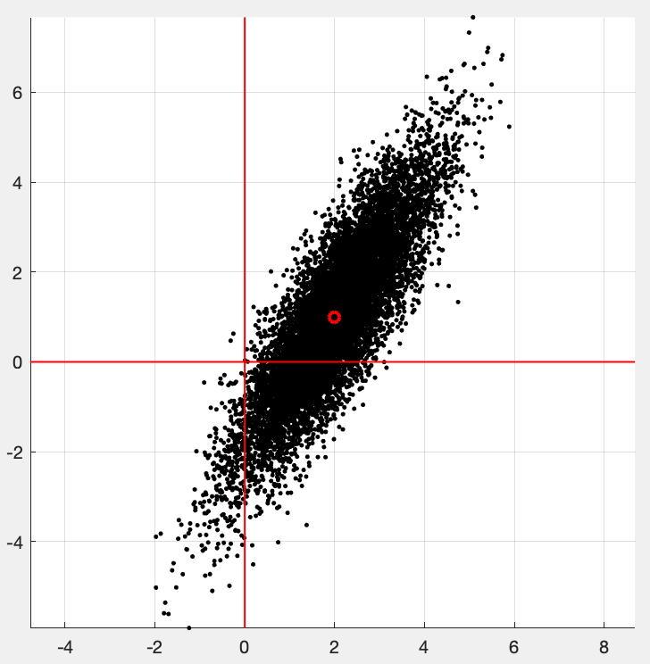
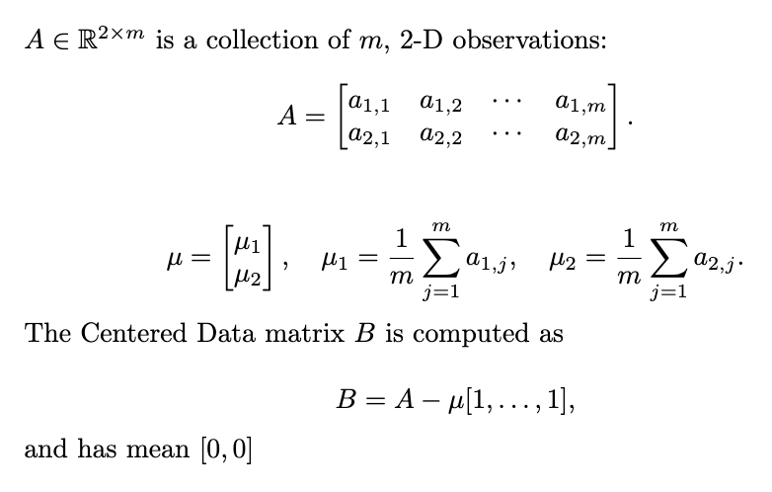
Statistical Approach to PCA
Center data around mean
Compute Covariance Matrix
Eigen system of Covariance matrix
CV = VΛ
Eigenvalues represent variances along principal axes
Eigenvectors represent directions of principal axes
Extract Principal Components and Interpret Results
T = BV are projections of data onto principal axes
Diagonal matrix Λ stores variance explained by each PC

Slide 5
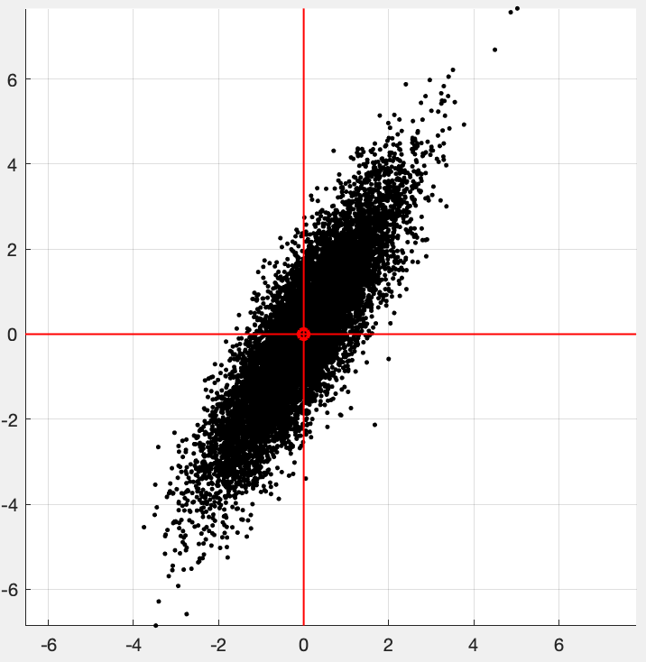
Statistical Approach to PCA
Center data around mean
Compute Covariance Matrix
Eigen system of Covariance matrix
CV = VΛ
Eigenvalues represent variances along principal axes
Eigenvectors represent directions of principal axes
Extract Principal Components and Interpret Results
T = BV are projections of data onto principal axes
Diagonal matrix Λ stores variance explained by each PC

Slide 6
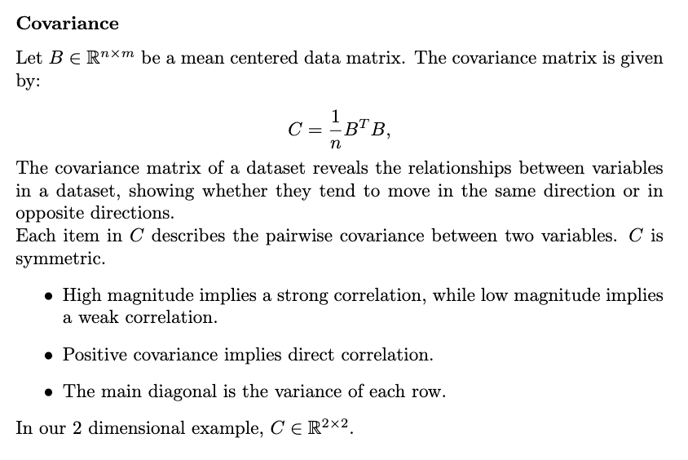
Statistical Approach to PCA
Center data around mean
Compute Covariance Matrix
Eigen system of Covariance matrix
CV = VΛ
Eigenvalues represent variances along principal axes
Eigenvectors represent directions of principal axes
Extract Principal Components and Interpret Results
T = BV are projections of data onto principal axes
Diagonal matrix Λ stores variance explained by each PC
Notes:
Sometimes the 1/m is 1/m-1.
See B transpose B. Notice the similarity between building C and computing the SVD Factorization (left singular vectors). The covariance matrix is just the correlation matrix of the SVD
.

Slide 7
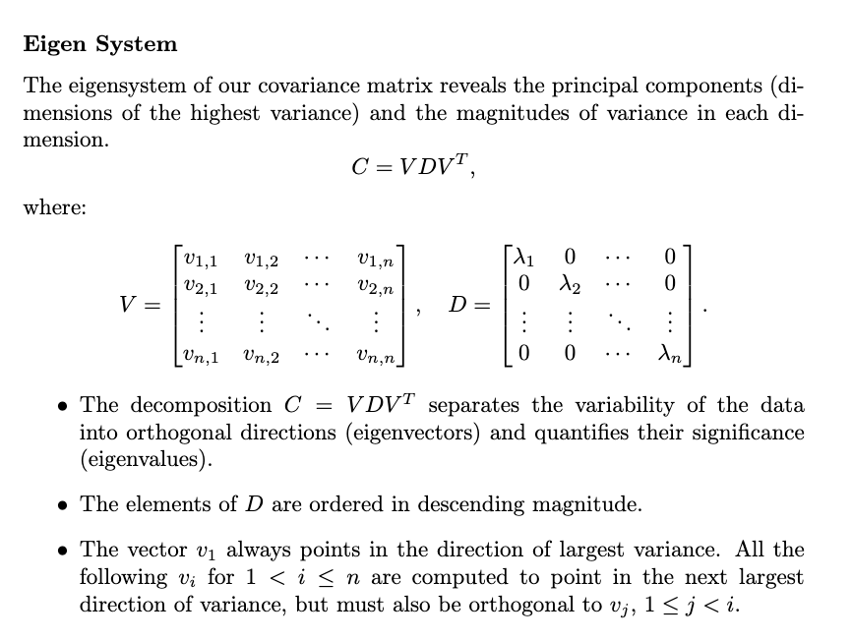
Statistical Approach to PCA
Center data around mean
Compute Covariance Matrix
Eigen system of Covariance matrix
CV = VΛ
Eigenvalues represent variances along principal axes
Eigenvectors represent directions of principal axes
Extract Principal Components and Interpret Results
T = BV are projections of data onto principal axes
Diagonal matrix Λ stores variance explained by each PC
Econ reduced V to n x m for m < n

Slide 8
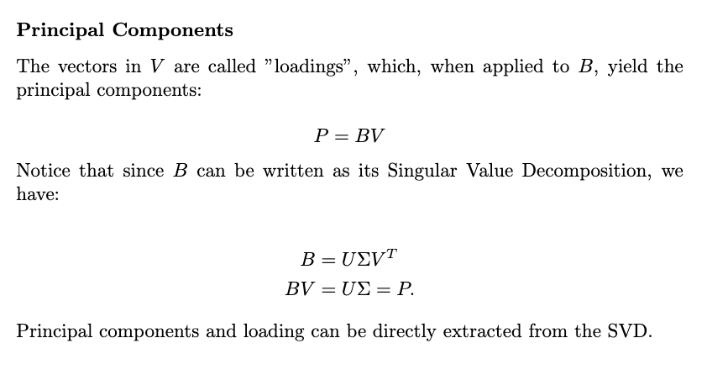
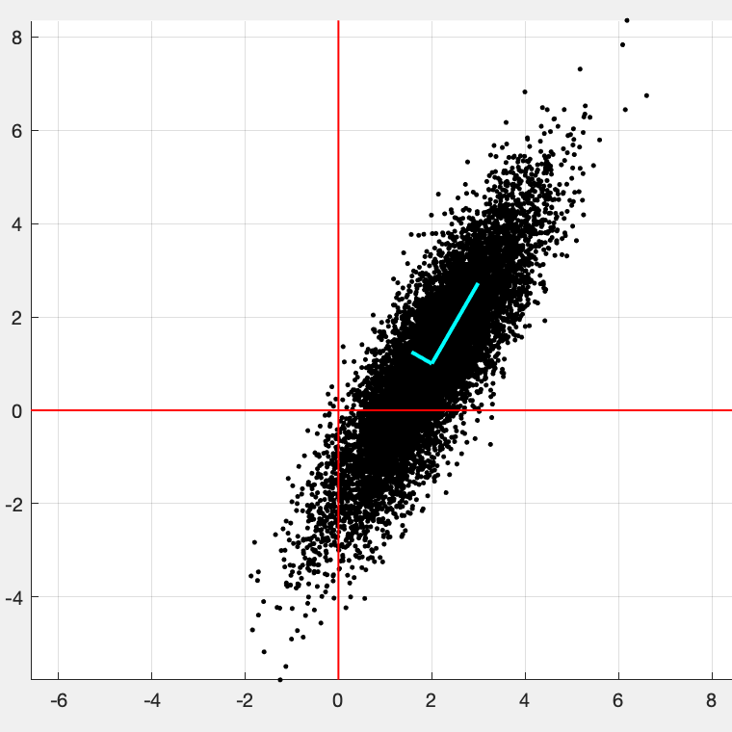

Statistical Approach to PCA
Center data around mean
Compute Covariance Matrix
Eigen system of Covariance matrix
CV = VΛ
Eigenvalues represent variances along principal axes
Eigenvectors represent directions of principal axes
Extract Principal Components and Interpret Results
T = BV are projections of data onto principal axes
Diagonal matrix Λ stores variance explained by each PC
Notes:
Think of loadings as a preimage of the PC’s. PC’s can be derived from both sides of the SVD equation.

Slide 9
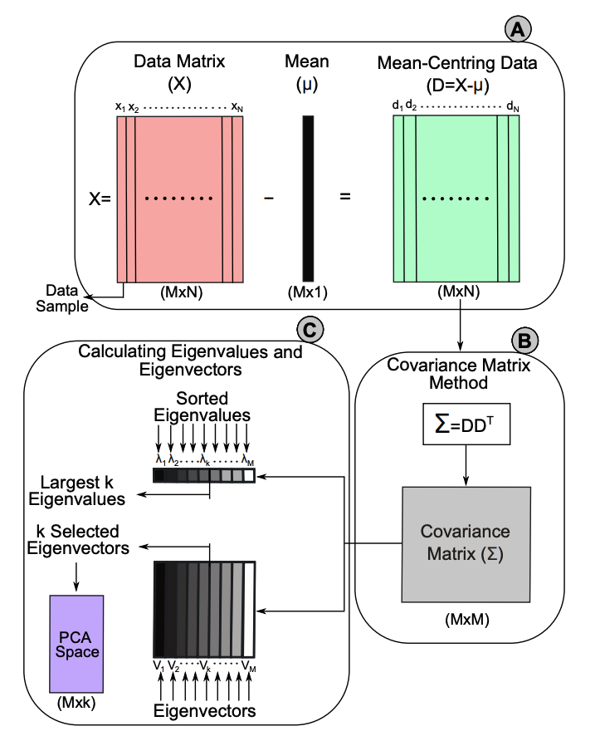
Statistical Approach to PCA
Center data around mean
Compute Covariance Matrix
Eigen system of Covariance matrix
CV = VΛ
Eigenvalues represent variances along principal axes
Eigenvectors represent directions of principal axes
Extract Principal Components and Interpret Results
T = BV are projections of data onto principal axes
Diagonal matrix Λ stores variance explained by each PC

Slide 10
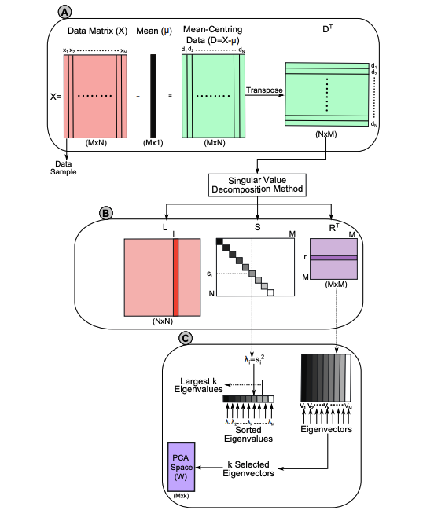
Emergence of the SVD
Expedited approach
Computationally efficient
Stable
Note*

Slide 11
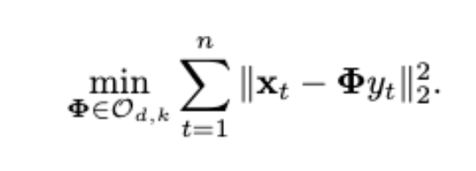
Singular Value Decomposition in Principal Component Analysis
The point of PCA is to reduce dimensions of a data matrix. The approach is to project data to a smaller dimension k. When we conduct a PCA from 2D into 2D…
Notes:
The choices of PC1 and PC2 minimize the residual of least squares AND maximize each point’s projected distance from the origin.

Slide 12


Example
Part II: Linking Genome to Ovarian Cancer

Slide 13
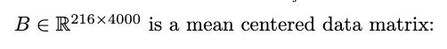
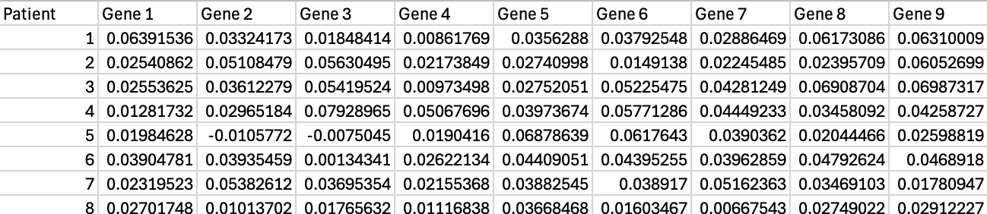
Goal
Can we predict a patient’s susceptibility to ovarian cancer given a set of 4000 numerical gene expressions?
Perhaps there are some “eigen genomes” that capture variance in patient genomes and relate to a risk of developing ovarian cancer.
If we can identify some primary genomes, then we can project otherwise high dimensional data into a lower dimension.

Slide 14
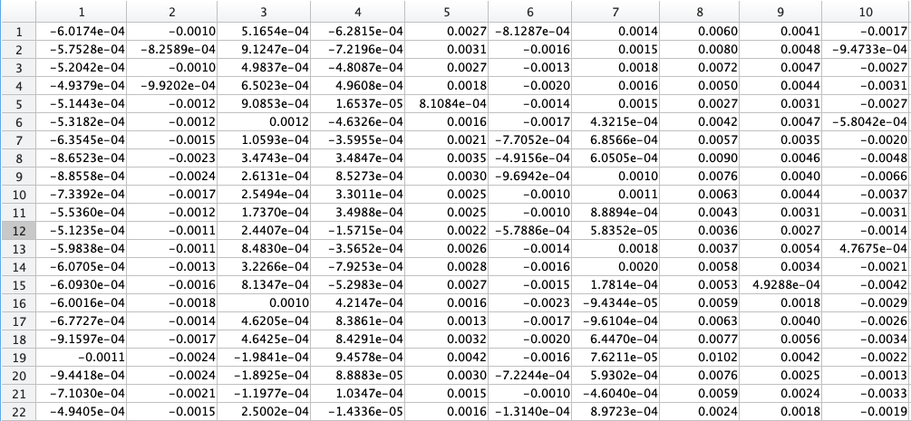
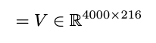
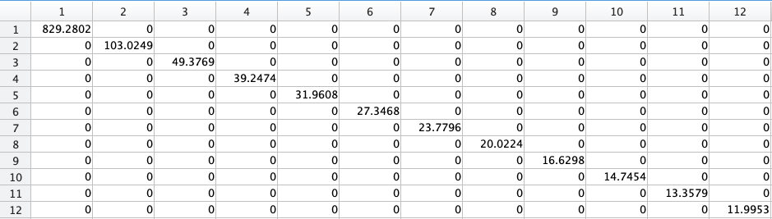
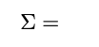
Notes:
The SVD provides these loading vectors and singular values. The columns of V essentially represent an “eigen genome”. Sigma shows the significance of each column.

Slide 15
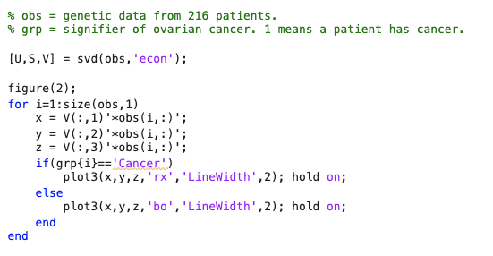
Dimensional Reduction from 4000 to 3
The loading space V is size 4000 by 216. Each column is an “eigen genome” which expresses the direction of maximum variance. Most genomes can be expressed as a linear combination of a few unique genomes.
This code takes an inner product of the top three eigen genomes with each observation. This process transforms the original data into a more visualizable 3-dimensional space where we can observe clustering patterns

Slide 16
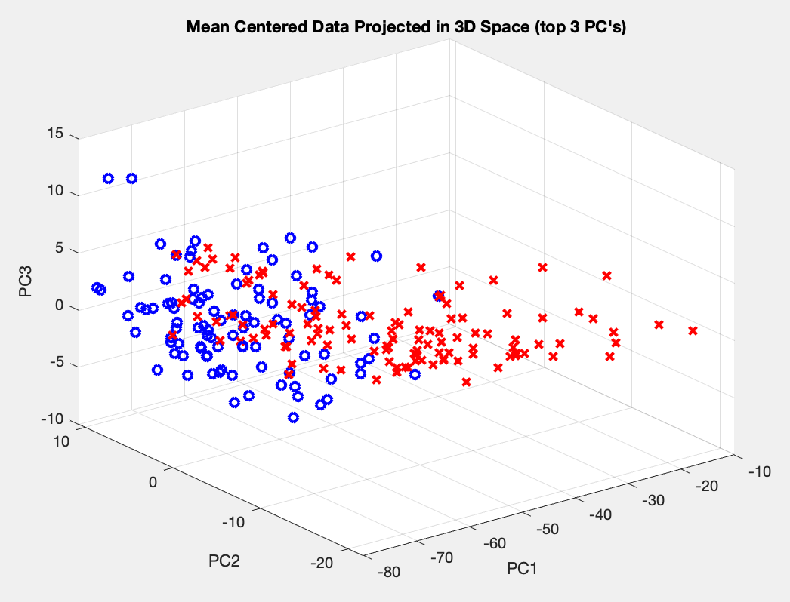
x = Cancer
o = No Cancer
Takeaway
If we know the inner produce of a patient’s genome with our three indicator genomes, then we can reasonably predict susceptibility to ovarian cancer.
Rather than checking 4000 genes expressions, the PCA allows us to check 3 inner products instead.
Notes:
The big visual takeaway is that two clusters emerge. If we plot some patient’s x, y, and z coordinates using their genome and this principal component decomposition, then we can confidently assess their risk of developing ovarian cancer.

Slide 17
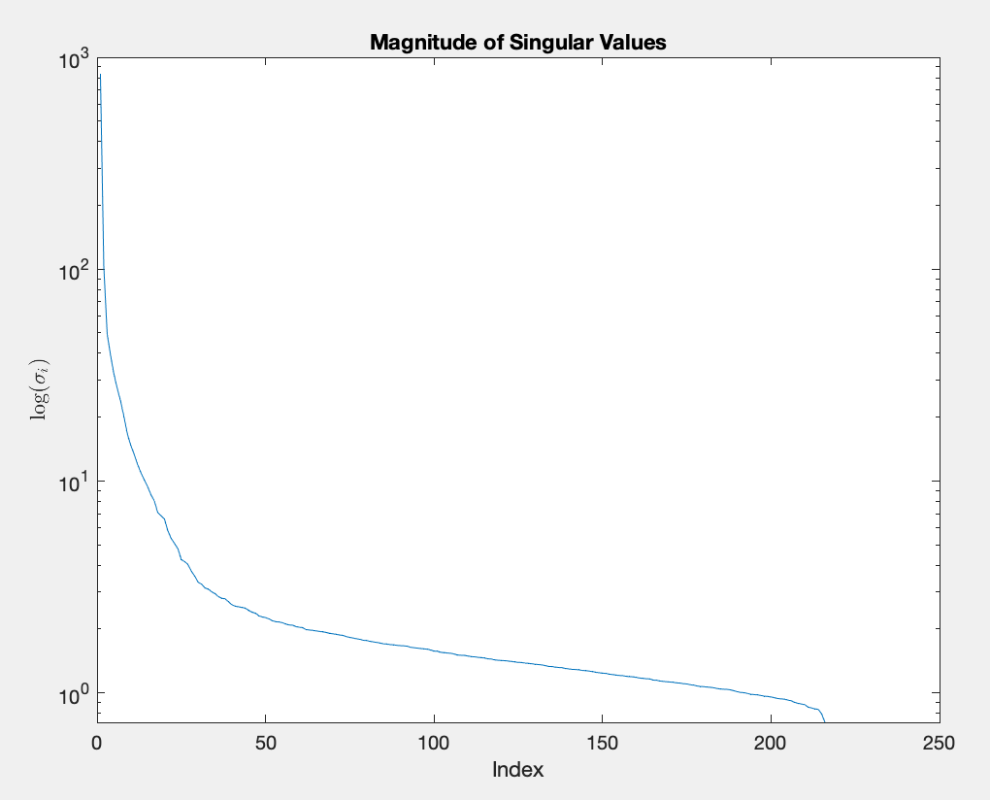
Singular Values
This rapid decay of our singular values indicates that our dimensional reduction still preserves a large portion of the original data, keeping mostly the important things. Can we quantify how much of the important data we are keeping?

Slide 18
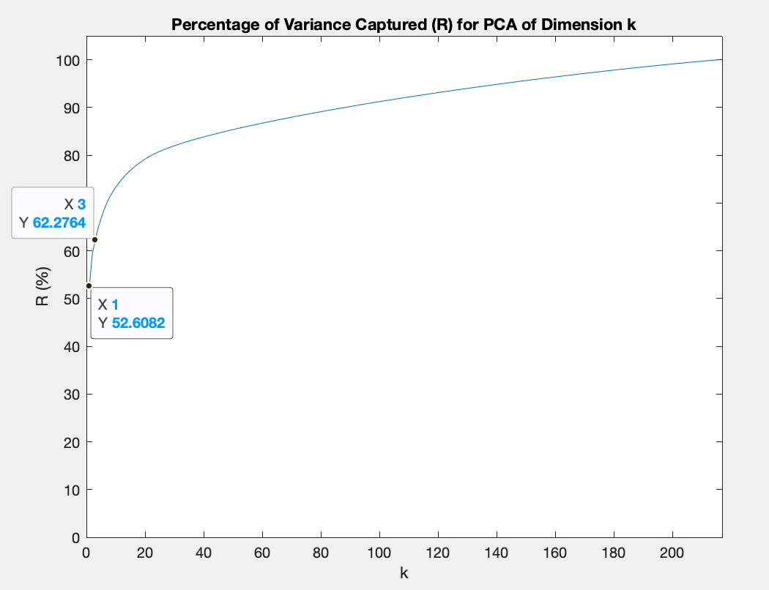
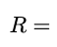
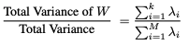
Robustness of PCA Space

Slide 19
Conclusion
Based on these three figures, we can say that this PCA dimension reduction provides a simple, accurate, and efficient way to represent a large data set.
If a priority of ours was to maximize accuracy at the expense of data visualizability, we could increase k beyond 3.
Notes:
school,sex,age,address,famsize,Pstatus,Medu,Fedu,traveltime,studytime,failures,schoolsup,famsup,paid,activities,nursery,higher,internet,romantic,famrel,freetime,goout,Dalc,health,absences,G1,G2,G3,,,,Walc

Slide 20
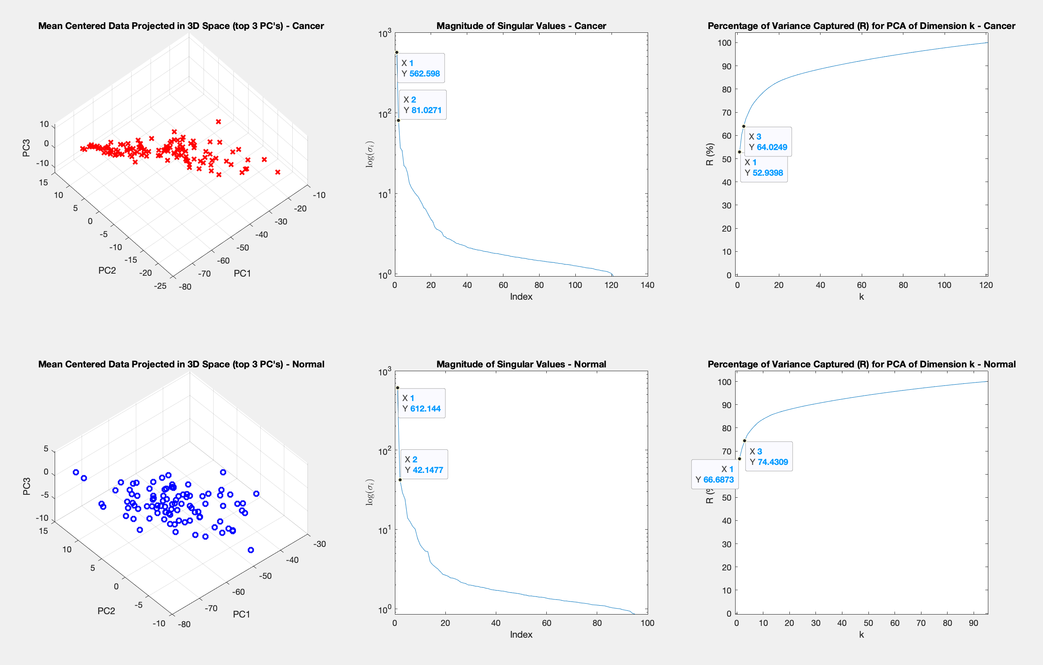
Further Investigation
Here’s what happens when we proceed with PCA only after splitting the data into a cancer and normal group. The first 3 primary components of the normal patients capture more variance than those of the cancer patients.
Notes:
school,sex,age,address,famsize,Pstatus,Medu,Fedu,traveltime,studytime,failures,schoolsup,famsup,paid,activities,nursery,higher,internet,romantic,famrel,freetime,goout,Dalc,health,absences,G1,G2,G3,,,,Walc

Slide 21


More Examples
Part III: Student Alcohol Consumption
&
Patient Diabetes / Health Data

Slide 22
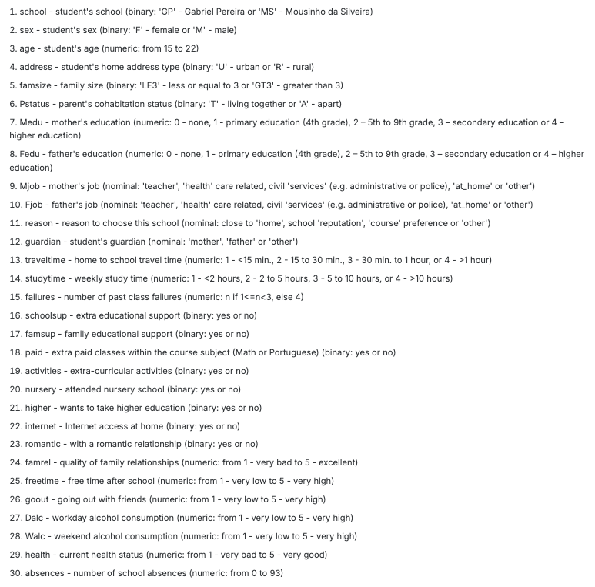
Student Alcohol Consumption data
Question: What factors (if any) relate to a student’s “Weekend Alcohol Consumption” quantity (from 1-5)?
Procedure: Convert data to numeric, identify principal components, visualize results.
Notes:
school,sex,age,address,famsize,Pstatus,Medu,Fedu,traveltime,studytime,failures,schoolsup,famsup,paid,activities,nursery,higher,internet,romantic,famrel,freetime,goout,Dalc,health,absences,G1,G2,G3,Walc

Slide 23

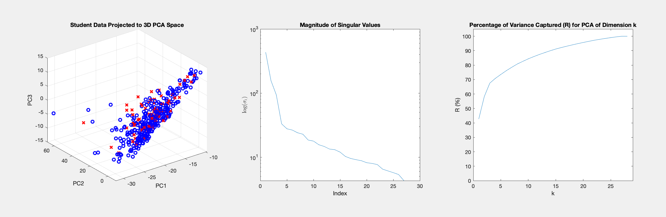
Student Alcohol Consumption PCA, k = 3
x: AC > 3
o: AC ≤ 3
Notes:
school,sex,age,address,famsize,Pstatus,Medu,Fedu,traveltime,studytime,failures,schoolsup,famsup,paid,activities,nursery,higher,internet,romantic,famrel,freetime,goout,Dalc,health,absences,G1,G2,G3,,,,Walc

Slide 24
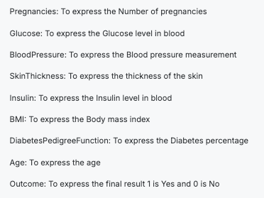
Diabetes And Health Data
Question: Can a combination of these variables indicate the presence of diabetes?
Procedure: Convert data to numeric, identify principal components, visualize results.
Notes:
school,sex,age,address,famsize,Pstatus,Medu,Fedu,traveltime,studytime,failures,schoolsup,famsup,paid,activities,nursery,higher,internet,romantic,famrel,freetime,goout,Dalc,health,absences,G1,G2,G3,Walc

Slide 25
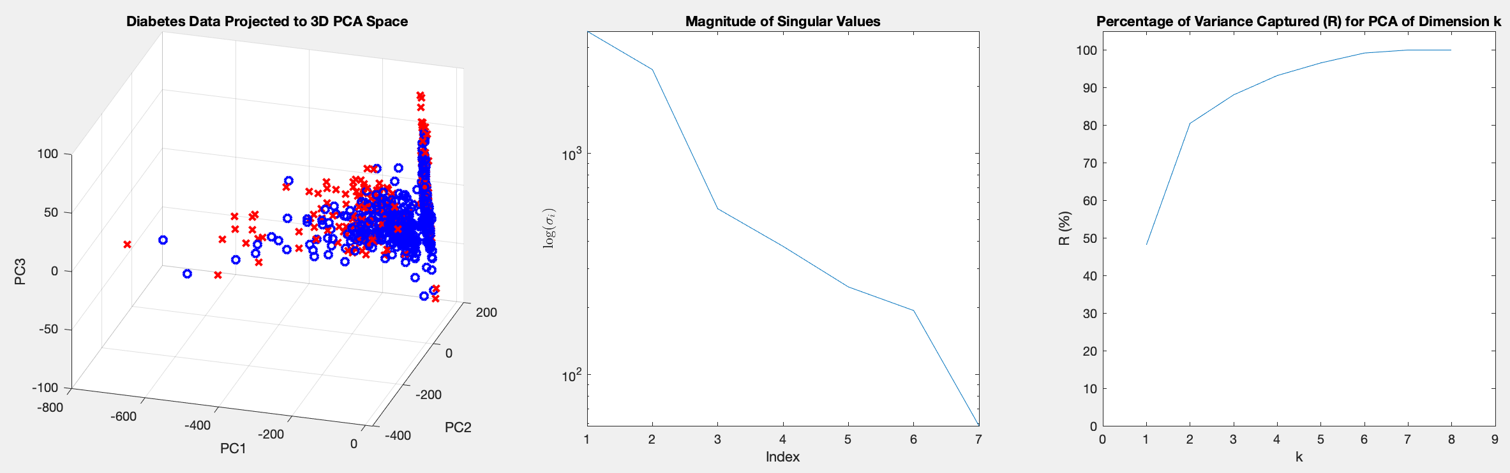
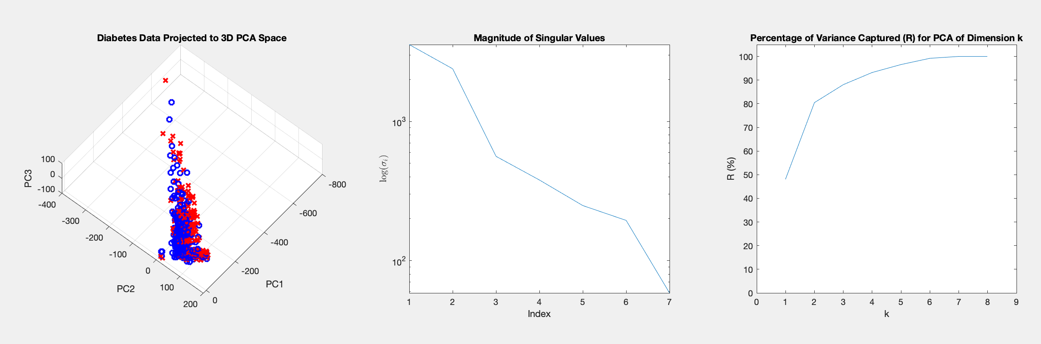
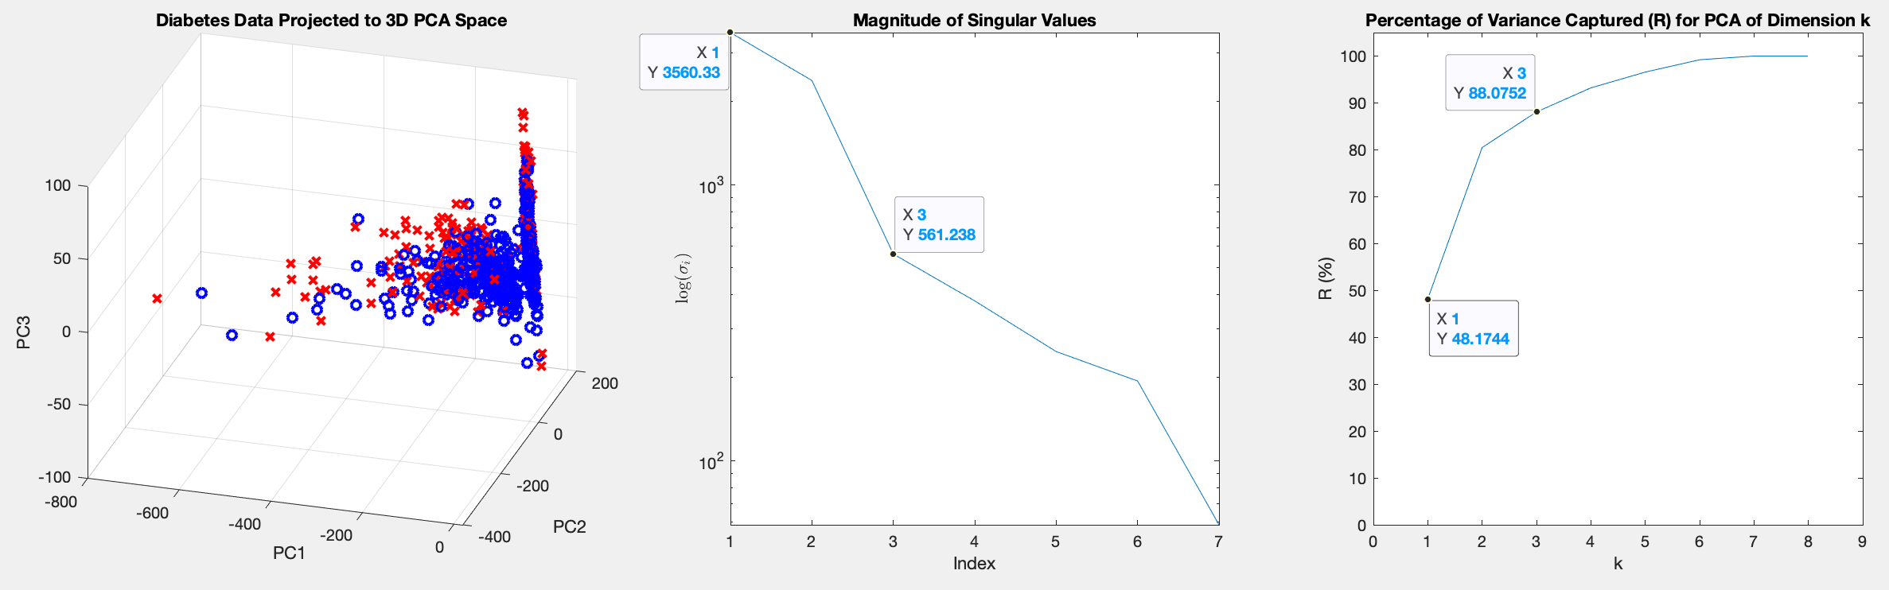
Diabetes Data PCA, k = 3
x = Diabetes
o = No Diabetes
Notes:
Note: The ”Magnitude of Singular Values” Plot is trimmed by 1 because the last value was on the order of -15.
Combing through these 8 fields is not as bad as combing through 4000 gene expressions. As such, this PCA isn’t as game changing as the ovarian cancer PCA.

Slide 26
Online PCA
Part IV: An Iterative Principal Component Construction Method
With a touch of Gram-Schmidt

Slide 27
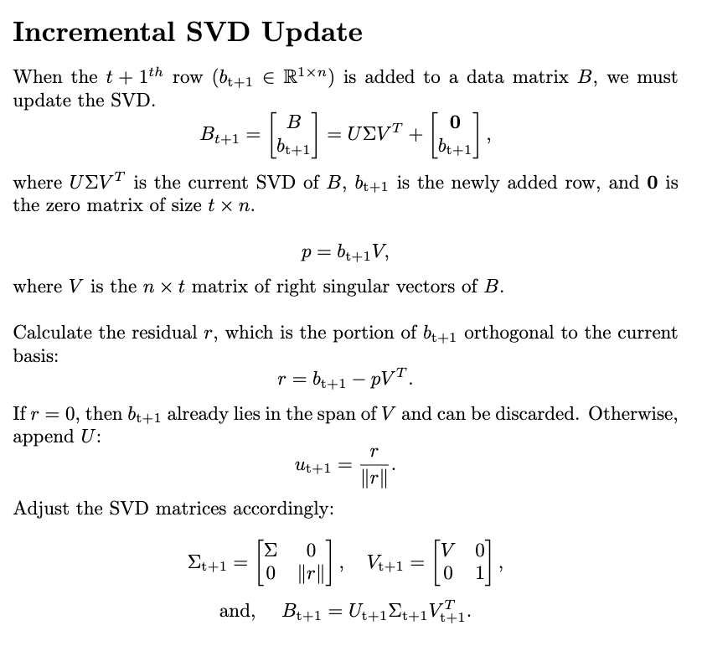
Appending the SVD
Other approaches include a vector wise update to the covariance matrix. A similar approach can be made directly to the SVD:
Notes:
This is applicable when data is entering a database in real time and maintaining an updated principal component basis is important. Also, there are cases where a data matrix is too big to be stored. When you know that most data will be ignored in the PCA construction, it saves space and time to use the Online PCA.

